Slide 1
EXPERT SYSTEM TO IDENTIFY BOOK FOR A GIVEN TOPIC
160030574-K.SIVA NANDINI
160030370-G.MANIKANTA
160031460-V.NAGESH

Slide 2
INTRODUCTION TO EXPERT SYSTEMS
A system which employs human expertise captured in a CBIS to solve problems which usually require human expertise. An expert system either supports or automates decision making in an area of which experts perform better than non experts. It is also known as "Expert Computing Systems", or "Knowledge Based Systems".

Slide 3
PURPOSE
Recording and distributing scarce expert knowledge Applying the expert knowledge to remote locations Ensuring the quality of problem solving Training experts out of ordinary people

Slide 4
Ability of Expert Systems:
Recognizing problems Recognizing solutions Explaining the choice of solution Selecting applicable solutions Dealing with incomplete information Restructuring problems Reducing the need for research

Slide 5
MySQLdb?
MySQLdb is an interface for connecting to a MySQL database server from Python. It implements the Python Database API v2.0 and is built on top of the MySQL C API.

Slide 6
Database Connection
Before connecting to a MySQL database, make sure of the followings −
You have created a database MYDATABSE.
You have created a table Books in MYDATABSE.
This table has fields Authrname, bkname, rating ,edition, publisher
Python module MySQLdb is installed properly on your machine.

Slide 7
IMPLEMENTATION
import sqlite3
conn = sqlite3.connect('my_database.sqlite')
cursor = conn.cursor()
print("Opened database successfully")
sql = "DROP TABLE IF EXISTS BOOKSS"
cursor.execute(sql)
cursor.execute('''CREATE TABLE BOOKSS
(Authrname varchar(100) PRIMARY KEY NOT NULL,
bkname TEXT NOT NULL,
rating INT NOT NULL,
edition INT NOT NULL,
publisher CHAR(50));''')

Slide 8
CONT..
cursor.execute("INSERT INTO BOOKSS (Authrname,bkname,rating,edition,publisher) VALUES ('Behrouz A Forouzan', 'Data Communication and Networking', 4, 1,'Vikram')");
cursor.execute("INSERT INTO BOOKSS (Authrname,bkname,rating,edition,publisher) VALUES ('William Stallings', 'Data Communication and Networking', 5,2, 'Vijay')");
cursor.execute("INSERT INTO BOOKSS (Authrname,bkname,rating,edition,publisher) VALUES ('Henry', 'Data Communication and Networking', 5,2, 'Saketh')");
cursor.execute("INSERT INTO BOOKSS (Authrname,bkname,rating,edition,publisher) VALUES ('Marwell', 'Data Communication and Networking', 4,2, 'Praveen')");
cursor.execute("INSERT INTO BOOKSS (Authrname,bkname,rating,edition,publisher) VALUES ('Oriz', 'Data Communication and Networking', 3,2, 'Keerthi')");

Slide 9
CONT..
cursor.execute("INSERT INTO BOOKSS (Authrname,bkname,rating,edition,publisher) VALUES ('Ivan BayaRoss','DBMS', 4,2, 'Vikram')");
cursor.execute("INSERT INTO BOOKSS (Authrname,bkname,rating,edition,publisher) VALUES ('Raghu RamKrishnan','DBMS', 5,1, 'Vijay')");
cursor.execute("INSERT INTO BOOKSS (Authrname,bkname,rating,edition,publisher) VALUES ('C.J.Date', 'DBMS', 3,1, 'Rahul')");
cursor.execute("INSERT INTO BOOKSS (Authrname,bkname,rating,edition,publisher) VALUES ('Bipin.C.Desai', 'DBMS', 2,3, 'Lakshman')");
cursor.execute("INSERT INTO BOOKSS (Authrname,bkname,rating,edition,publisher) VALUES ('SilberSchatz', 'DBMS', 1,3, 'Reshma')");

Slide 10
CONT…
x=0
n=input("Enter the textbook:")
print("Total books avbl for your required topic:"+n)
m="SELECT * FROM BOOKSS WHERE bkname = {}".format(n)
for row in cursor.execute(m):
x=x+1
print(" Authrname= ", row[0])
print ("bkname = ", row[1])
print ("rating= ", row[2])
print ("edition= ",row[3])
print ("publisher= ",row[4]), "\n"
print("\n So total books avbl are:"+str(x))
print("\n\n")

Slide 11
CONT….
print("BEST BOOK BASED ON RATING\n")
m="SELECT * FROM BOOKSS WHERE bkname = {} and rating=(SELECT MAX(rating) from BOOKSS) ".format(n)
for row in cursor.execute(m):
print(" Authrname= ", row[0])
print ("bkname = ", row[1])
print ("rating= ", row[2])
print ("edition= ",row[3])
print ("publisher= ",row[4]), "\n"

Slide 12
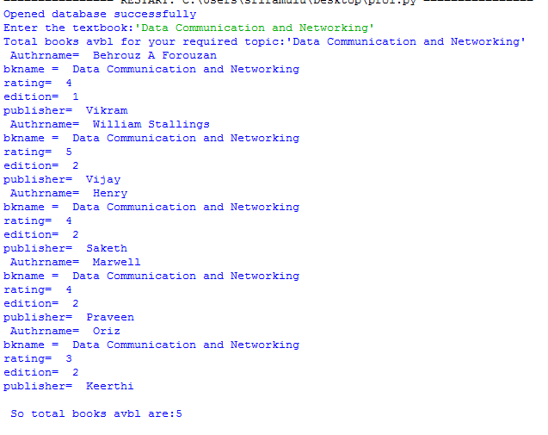
OUTPUT:

Slide 13

OUTPUT

Slide 14
CONCLUSION
By this expert system we can easily find out the best rating book…

